Slide 1
Case study: Sentiment Analysis
Liqun Chen
Jan 6th 2020

Slide 2
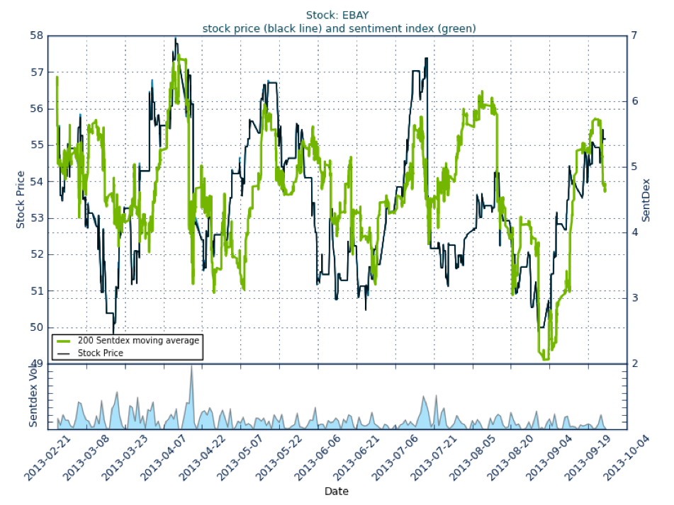


Why do we need to classify texts?
As a self-sufficient task:
Spam filtering
Sentiment analysis
Fake news detection

Slide 3
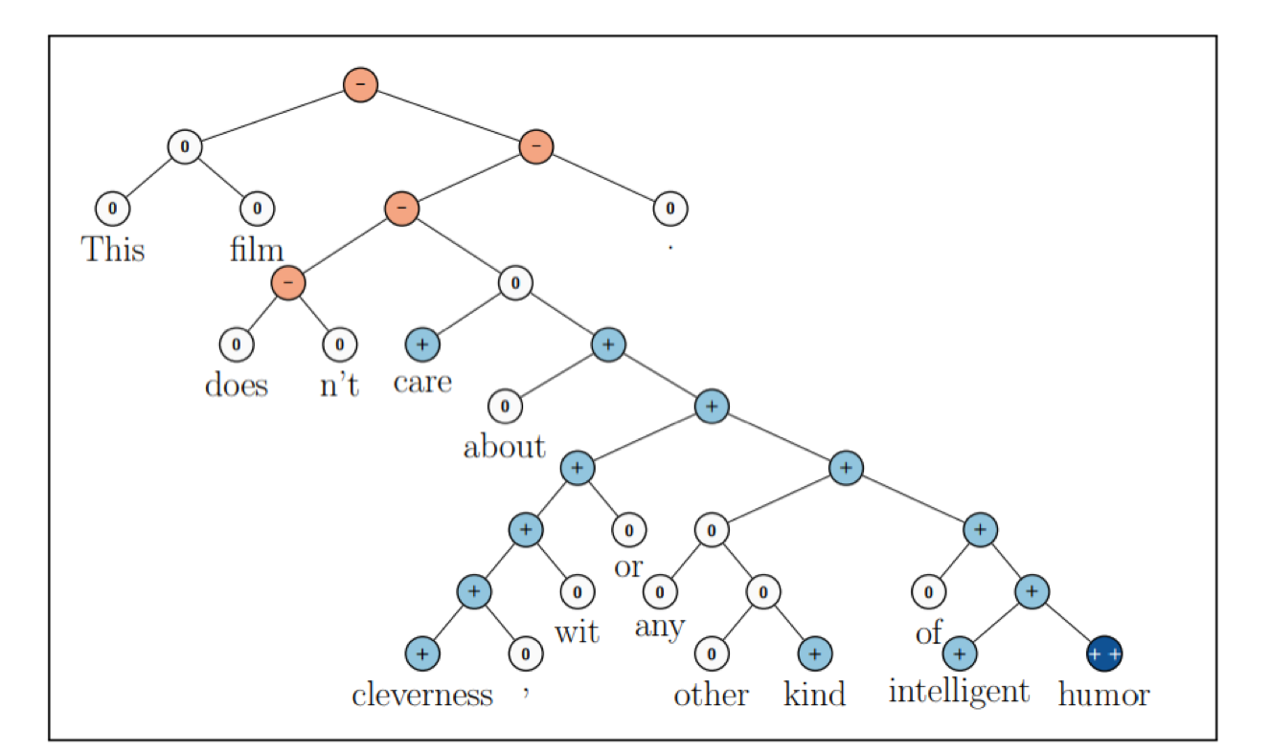
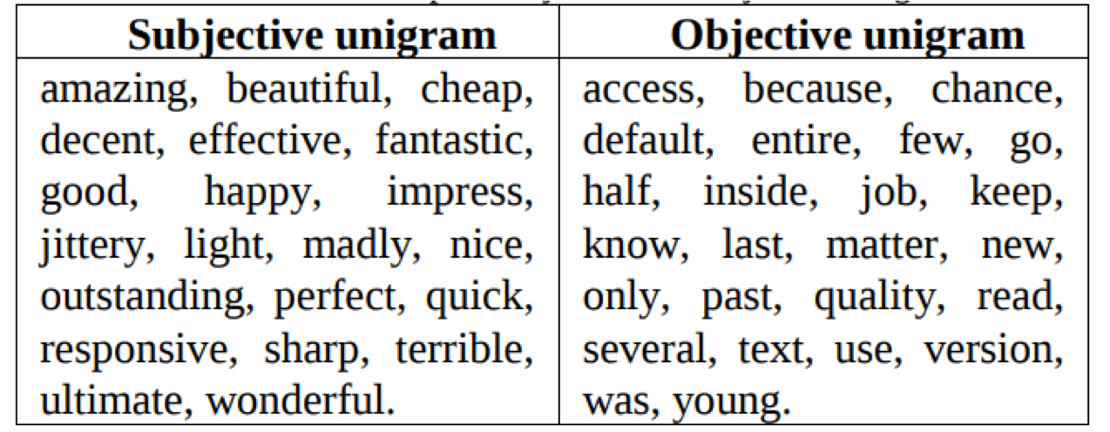
Popular Benchmarks

Slide 4
Sentiment classification in general

Slide 5
Text labels
Discrete labels:
Label is known:
Binary classification: spam filtering/sentiment analysis
Multi-class classification: categorization of goods
Multi-label classification: #hashtag prediction
Continuous labels: predict a price by a product description

Slide 6
Sentiment classification in general

Slide 7
Classification Algorithms
Maximum Entropy Method
i.e. sklearn.linear_model.LogisticRegression
Multinomial Naive Bayes
i.,e. sklearn.naive_bayes.MultinomialNB

Slide 8
Sentiment classification in general

Slide 9
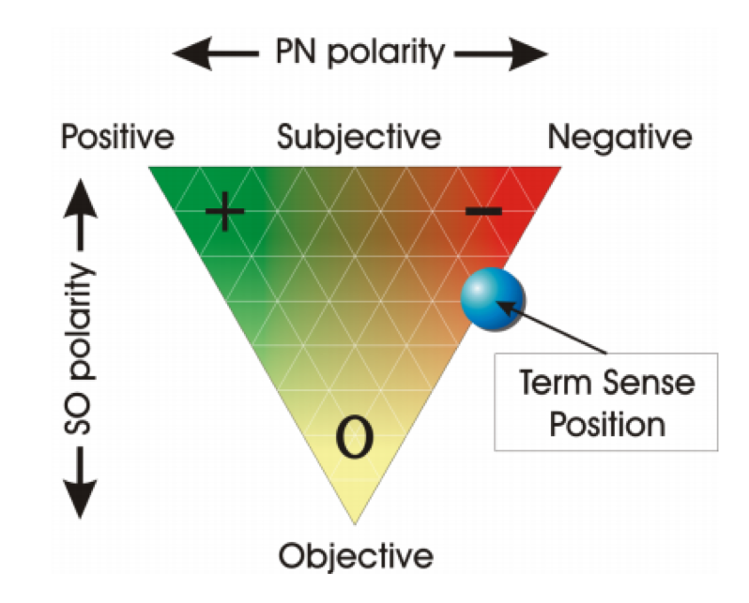
Text representation: feature engineering
General statistics: text length, text length variance,...
Scores from tagged word lists:
Sentiment dictionaries: SentiWordNet, SentiWords, ...
Subjectivity/objectivity dictionaries
Syntactic features:
POS tags
Ad-hoc features: e.g. number of emojis

Slide 10
Sparse text representation: BOW

Slide 11
Problems with BOW representation:
The number of features as many as words in a vocabulary. So called “parameter explosion”
Absence of context
All words are treated identically.

Slide 12
Dense text representation: NBOW
Instead of sparse one-hot encoding we can you use pre- trained word embeddings. It is so-called “neural bag-of- words”.
Advantages:
1. Feature space has lower dimensionality
2. We utilize external data (monolingual data in case
W2V, GloVe) →transfer learning
3. Words are treated not identically (an embedding
space has its own non-trivial structure)

Slide 13
BOW and NBOW: the shared problems
1. The importance weights for the word vectors aren’t defined fully.
2. The only way to use context for these models is to utilize word ngrams.

Slide 14
Multilayer perceptron
The simplest learnable aggregation function is a multilayer perceptron (stacked dense layers).
Problems:
1. Absence of the translational invariance z
(weights is specific for absolute word coordinate).
2. No parameter sharing.

Slide 15
Convolutional Neural Network
A convolution kernel is a tensor of size: [output dim, embedding dim, kernel size]

Slide 16
Convolutional Neural Network

Slide 17
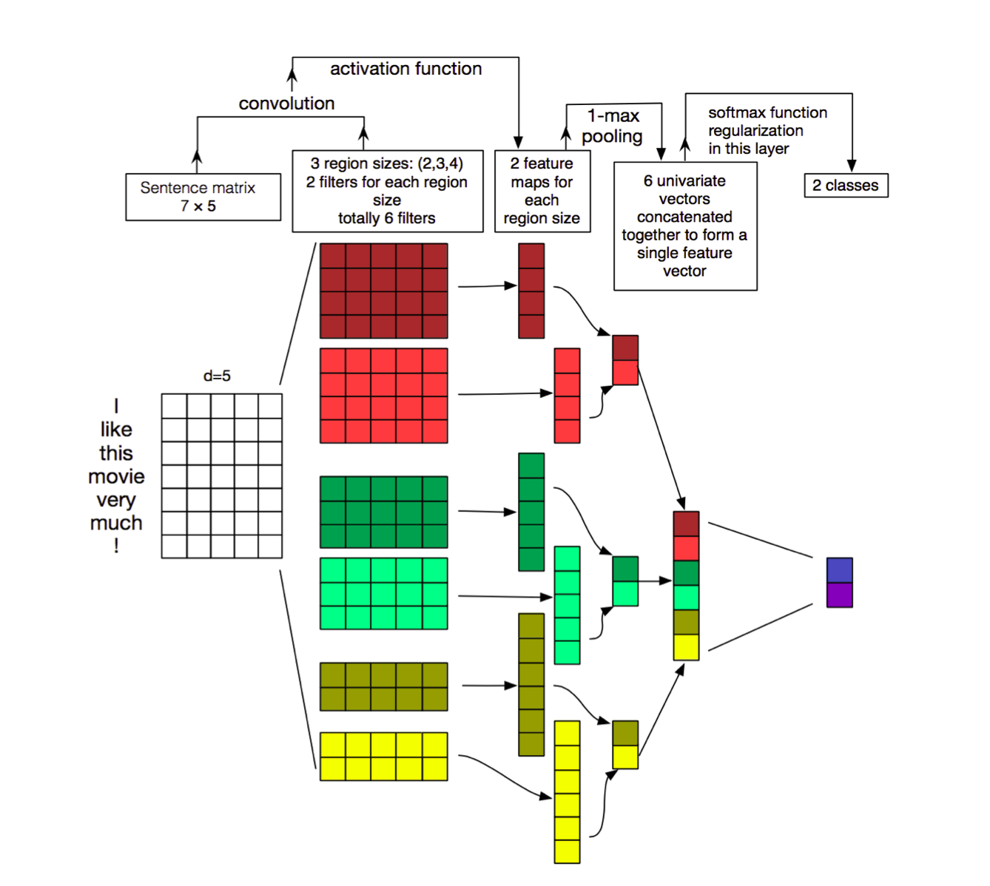
CNN improvement
Use convolutional layers with different kernel size, separate max- pooling over time and concatenation.
K-max pooling: take not 1 but k highest activations in their original order. E.g. (0,1,3,2,0,1,4,1) → (3,2,4)
Use pre-trained word vectors only for embedding layer initialization, train it jointly with model
https://arxiv.org/abs/1510.03820

Slide 18
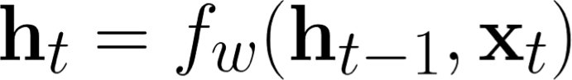
Recurrent NN for sentiment classification
In a RNN Connections between nodes form a directed graph along a sequence.
There are different types of recurrent units: vanilla RNN, LSTM, GRU

Slide 19
Recurrent NN for sentiment classification

Slide 20
RNN for sentiment classification

Slide 21
CNN vs RNN
With a lot of reservations RNNs demonstrates slightly better results on the benchmark classification tasks.
CNNs work well on the tasks that can be reduced to keyword search. Keyword mean angry terms and so on.
Also, RNNs have slower inference than CNNs. CNNs are easier to train.
For RNN you need more data
However, It’s seems to be very task-dependent thing. So you should try both options.

Slide 22
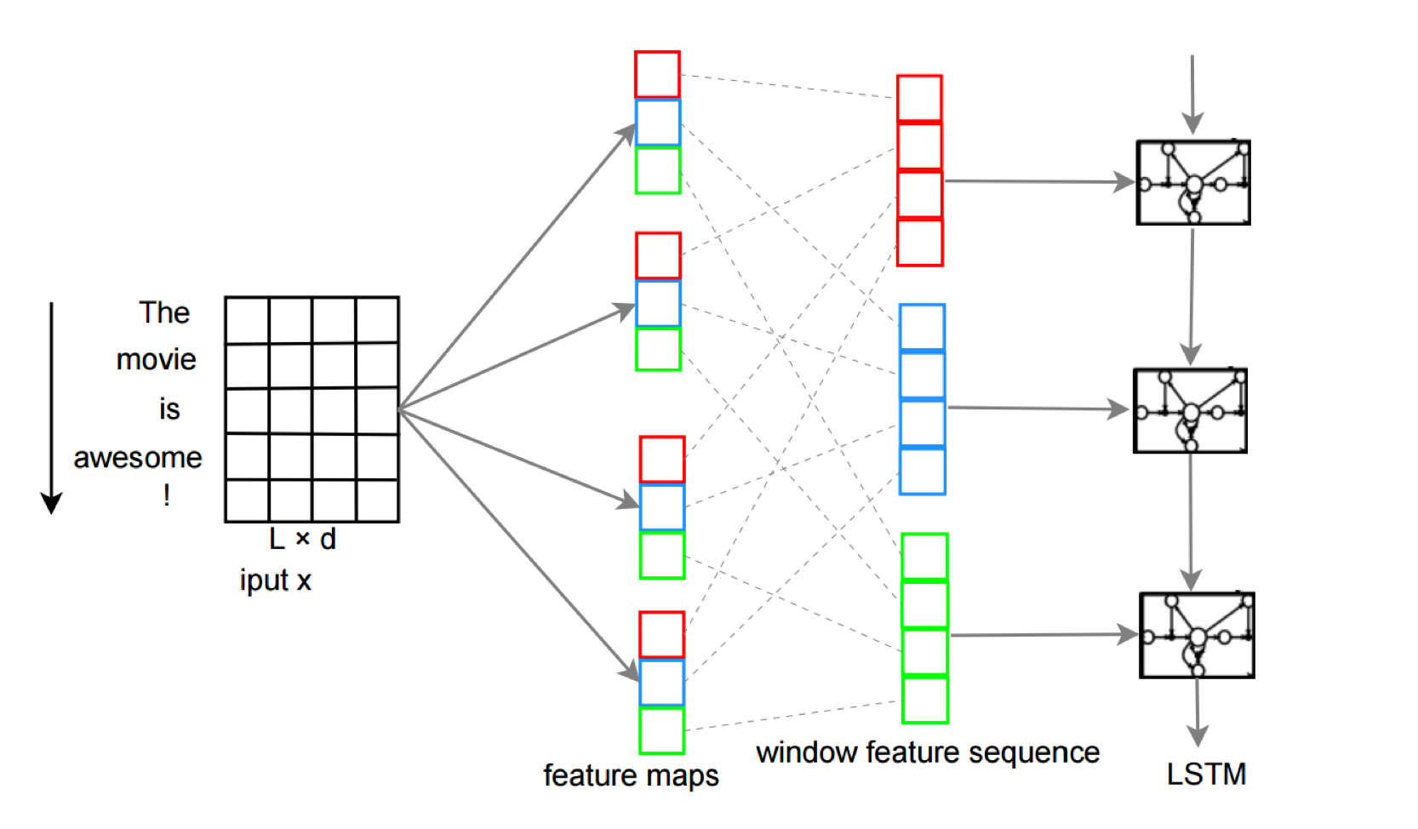
RNN-CNN model
C-LSTM [Zhou et al. 2015] [conv.]->[LSTM]
C-LSTM utilizes CNN to extract a sequence of higher-level phrase representations, and are fed into a long short-term memory recurrent neural network (LSTM) to obtain the sentence representation.

Slide 23
Case study: Next Word prediction
Liqun Chen
Jan 6th 2020

Slide 24
Language modeling
The goal of language modelling is to estimate the probability distribution of various linguistic units:
symbols
words
any token sequences
Next word prediction == training a language model

Slide 25
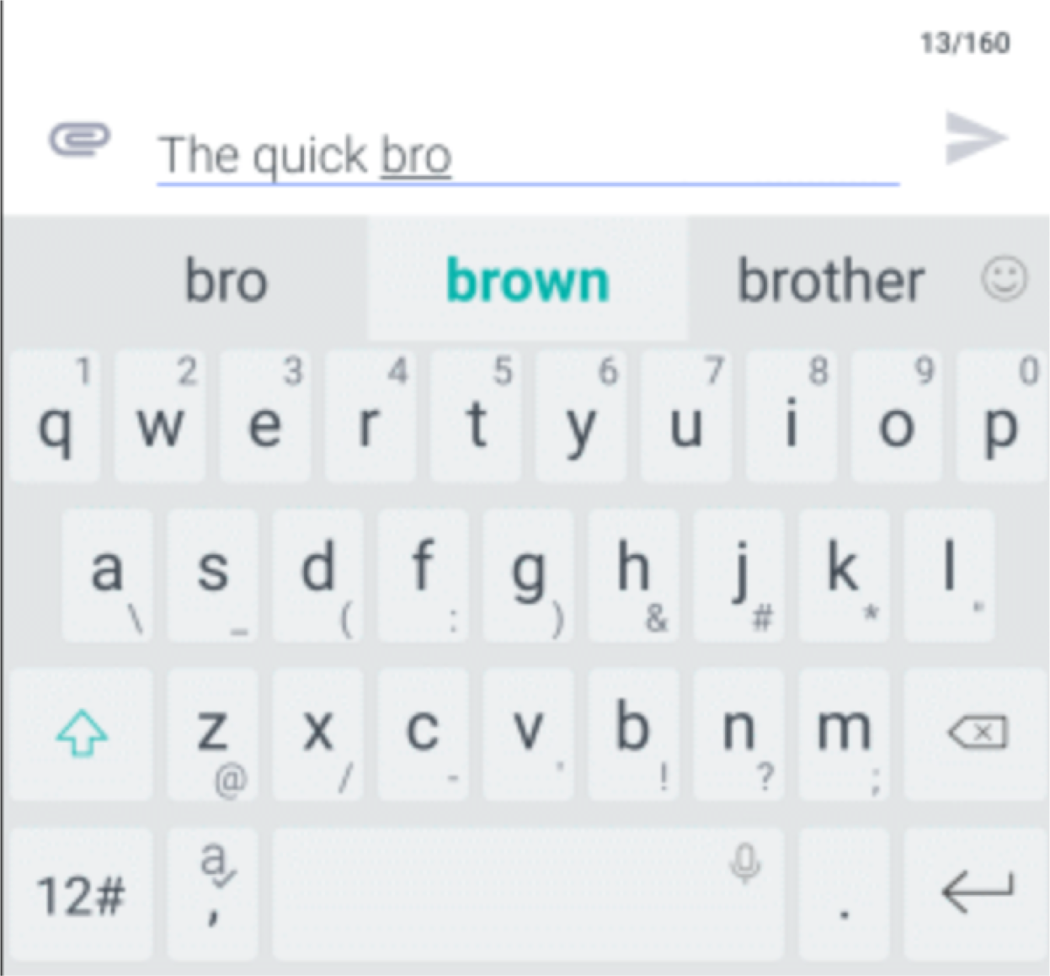
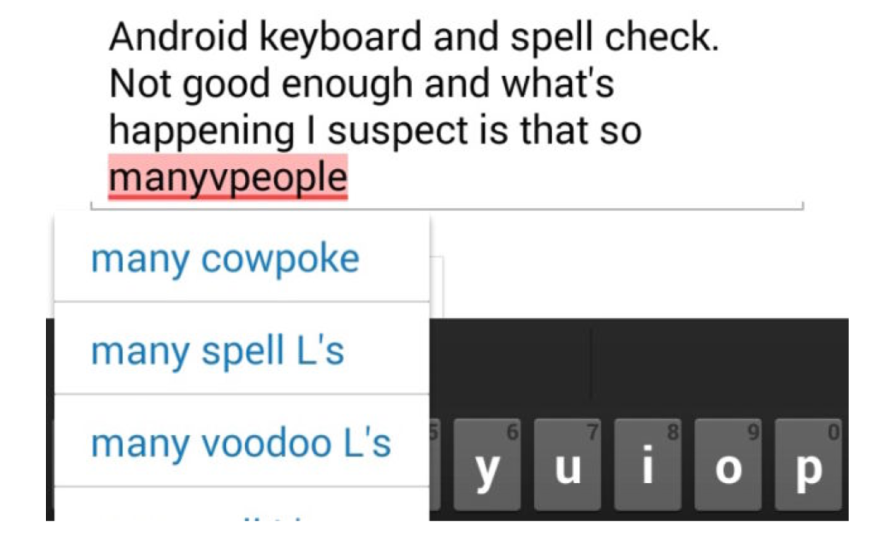
Where could we see LMs?

Slide 26
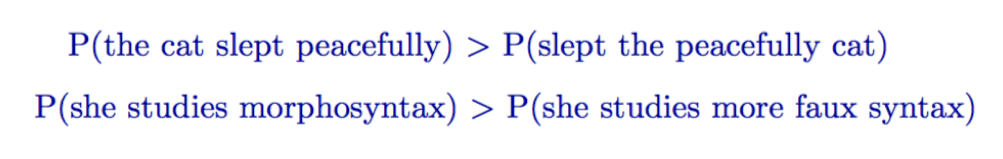
Sentence probabilities: intuitive interpretation
“Probability of a sentence” = how likely is it to occur in natural language
Consider only a specific language (English)

Slide 27
Language models in NLP
It’s very difficult to know the true probability of an arbitrary sequence of words.
It’s very difficult to know the true probability of an arbitrary sequence of words.
Like all models, language models will be good at capturing some things and less good for others.

Slide 28
N-gram Language Models
We want to estimate P(s=w1,w2,..,wn)
Example: P(s = the cat slept quietly)
This is a joint probability over the words in sentence s:
P(w1=the, w2=cat, w3=slept, w4=quietly)
Recall that for a joint probability, P(X, Y) = P(Y|X)P(X), so:
P(the cat slept quietly) = P(quietly | the cat slept) P(the cat slept) =
P(quietly | the cat slept) P(slept | the cat) P(cat | the) P(the)

Slide 29
N-gram Language Models
The chain rule gives us:
$$P\left(w_{1},w_{2},..,w_{n}\right)=Π_{i}^{n}P(w_{i}|w_{1},…,w_{i−1})$$

Slide 30
Example: 4-gram model

Slide 31
Neural Language Model
Recurrent language models: GRU, LSTM,…

Slide 32
RNN Language Model
RNN Advantages:
Can process any length input
Model size doesn’t increase for longer input
Computation for step t can (in theory) use information from many steps back
representations shared across timesteps
Remaining Problems:
Recurrent computation is slow
In practice, difficult to access information from many steps back

Slide 33
Training RNN-LM to predict next word

Slide 34
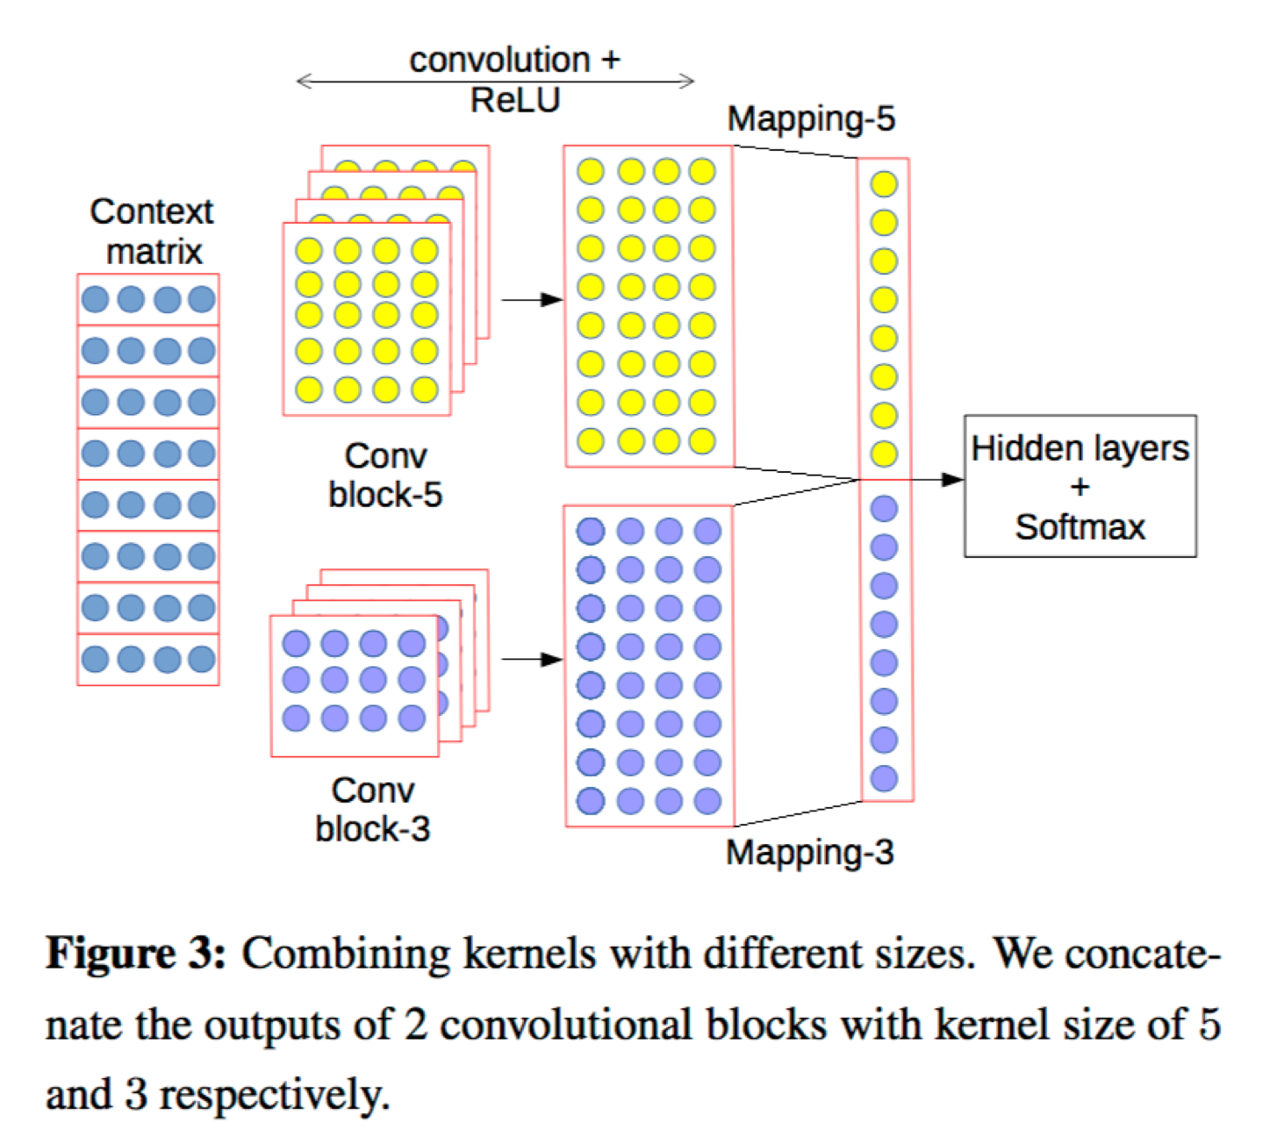
Other model variants
Pham et al, EMNLP 2016, https://www.aclweb.org/anthology/D16-1123

Slide 35
Thanks for your attention!

